Slide 1
32-bit MIPS Processor
By: Demarcus Simmons

Slide 2
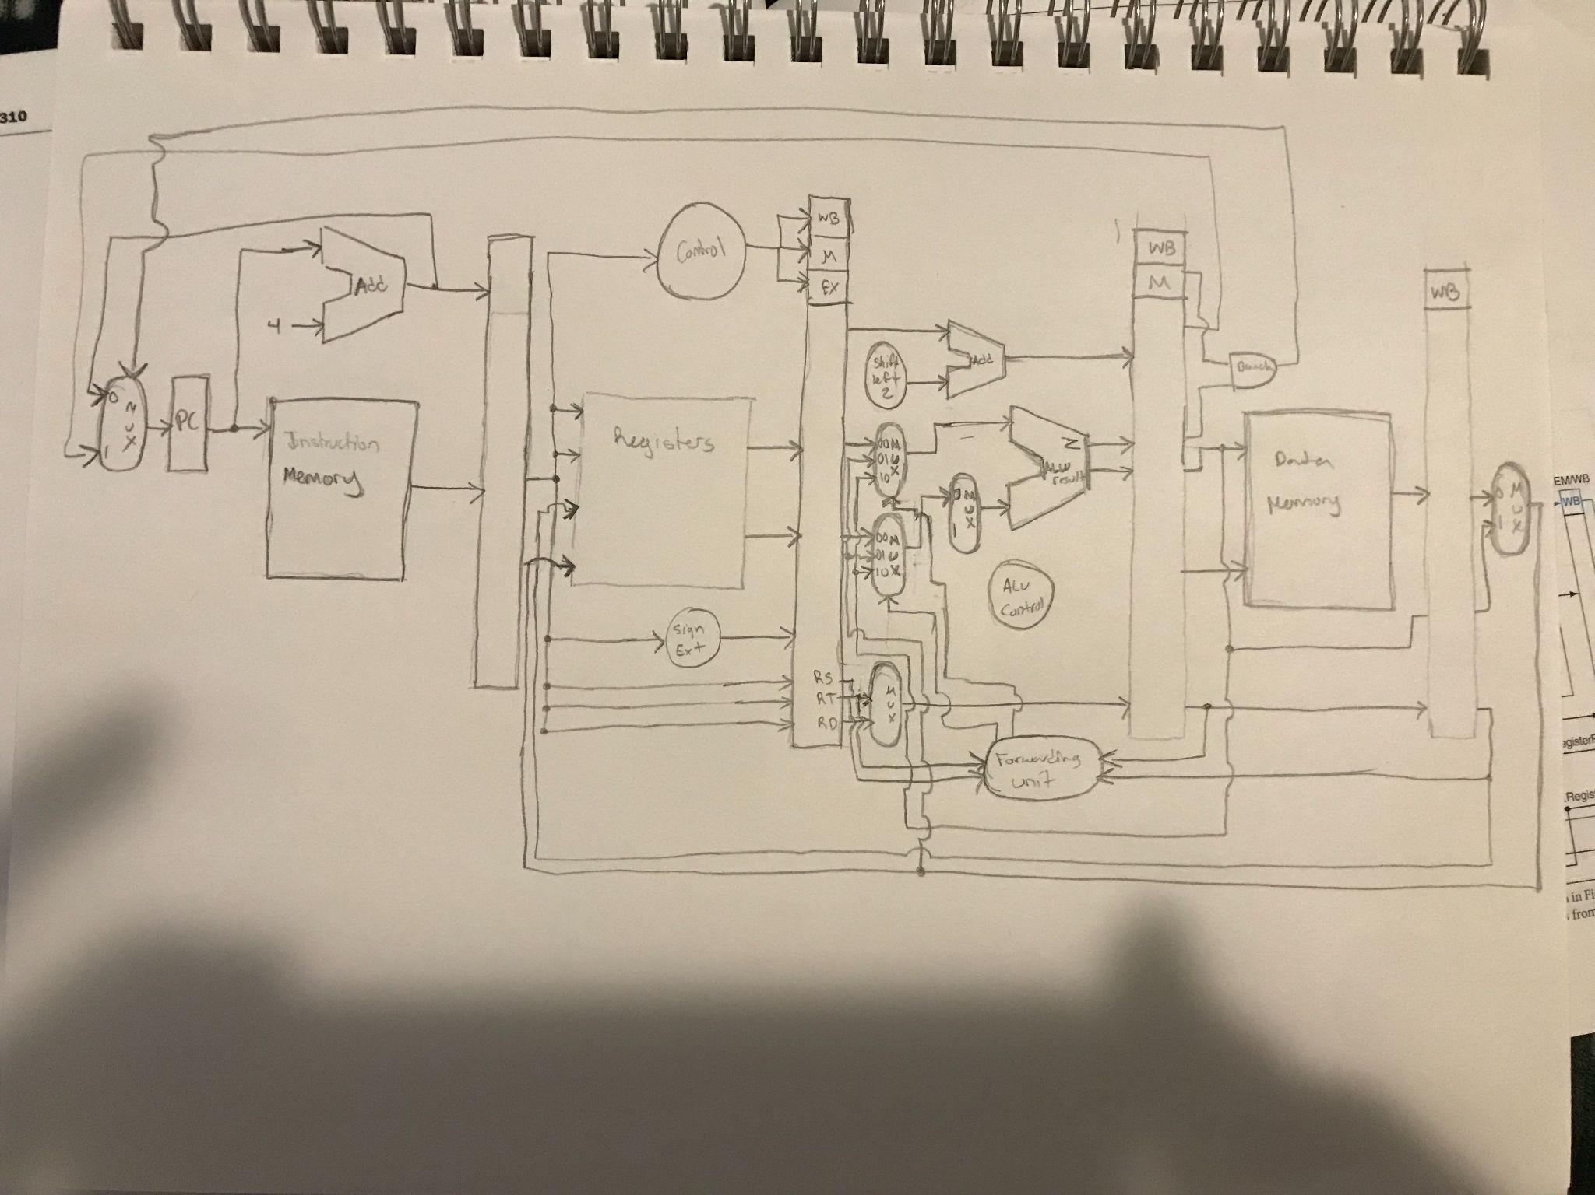

Slide 3
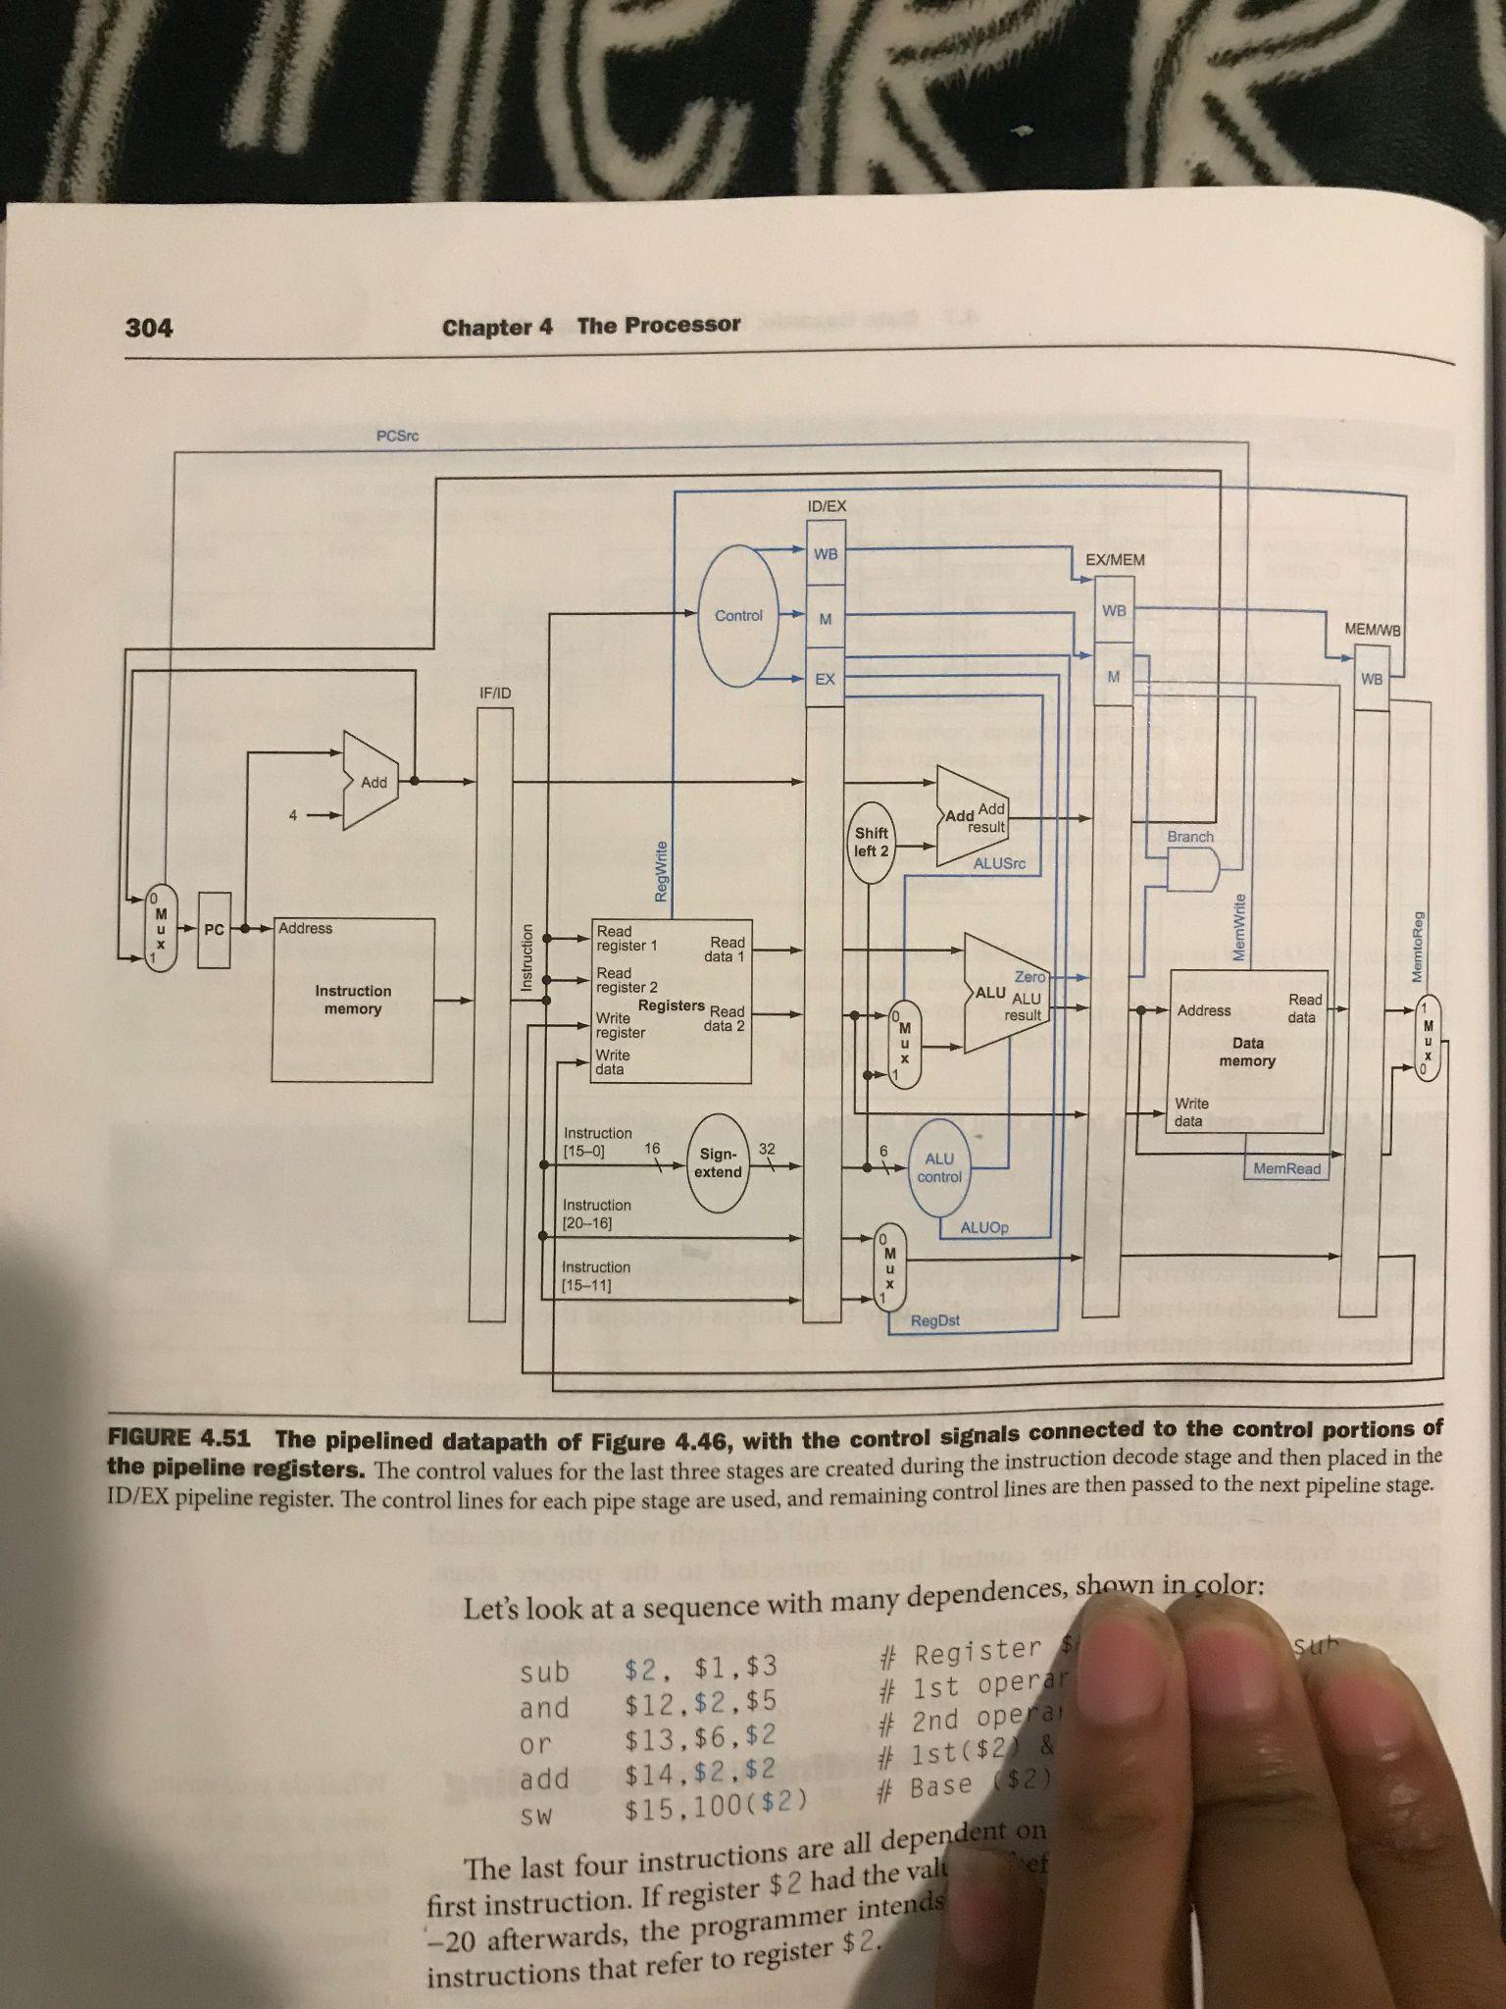
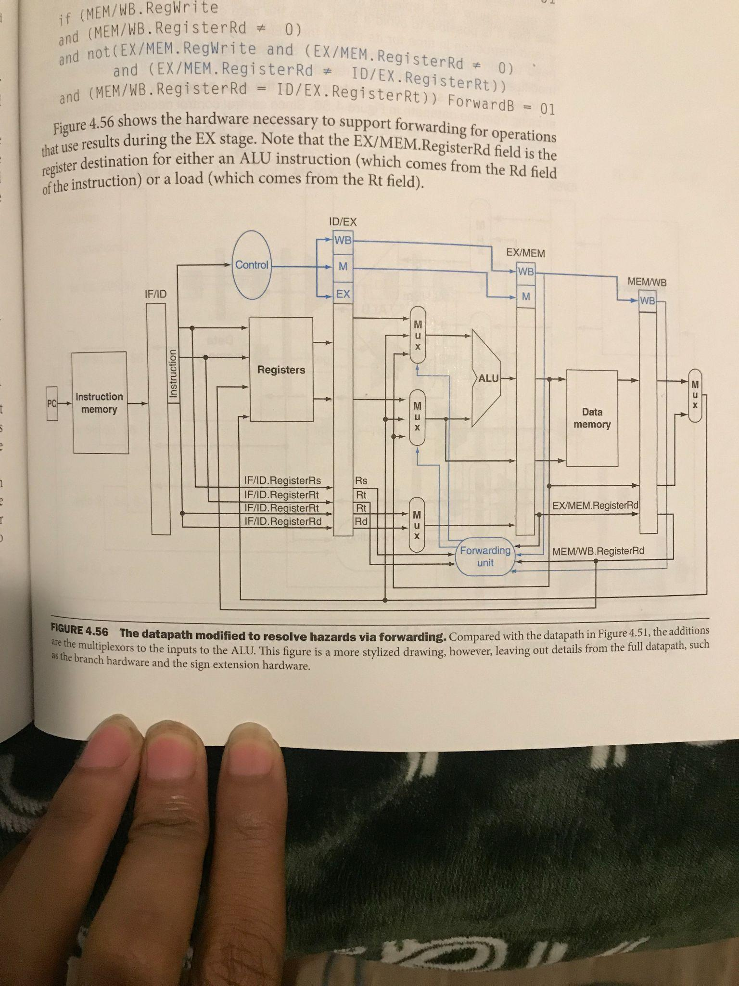

Slide 4
Design
Allowed Instructions:
Load Word
Store Word
Branch if equal
R-type:
Add
Subtract
And
Or
Nor
Set on Less Than

Slide 5
Design
Components:
Control
ALU
ALU control
RegFile
Program counter
Data Memory
Instruction Memory
IF/ID, ID/EX, EX/MEM, MEM/WB Registers
Adders
Multiplexers
Shift Left 2 unit
Sign extend unit
Forwarding unit

Slide 6
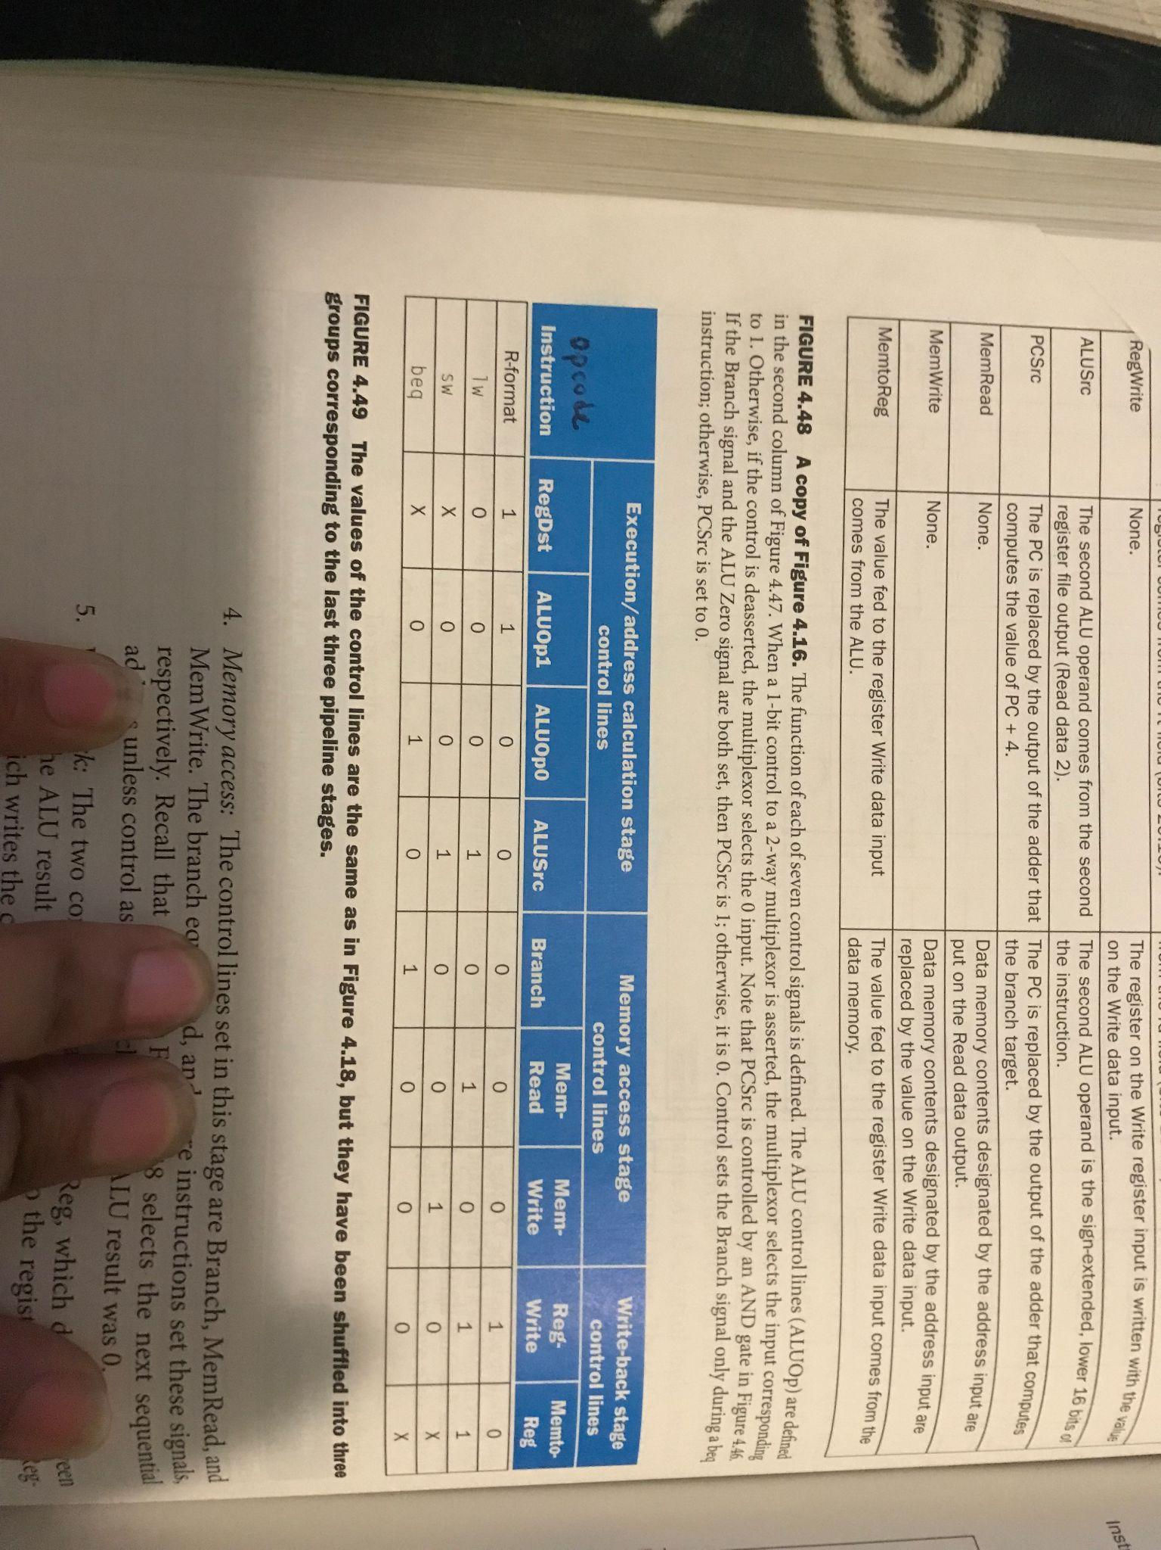
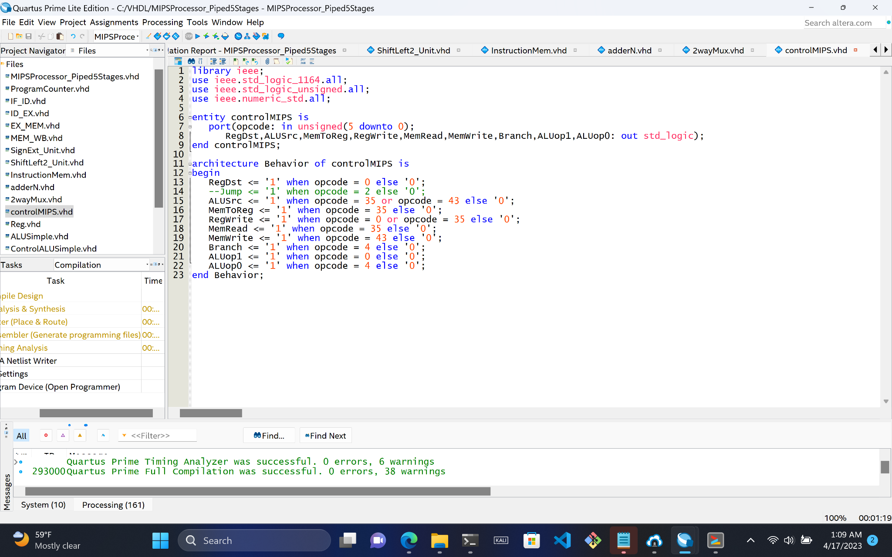
Control
1 Input:
opcode
9 Outputs:
RegDst
ALUSrc
MemtoReg
RegWrite
MemRead
MemWrite
Branch
ALUop1
ALUop0

Slide 7
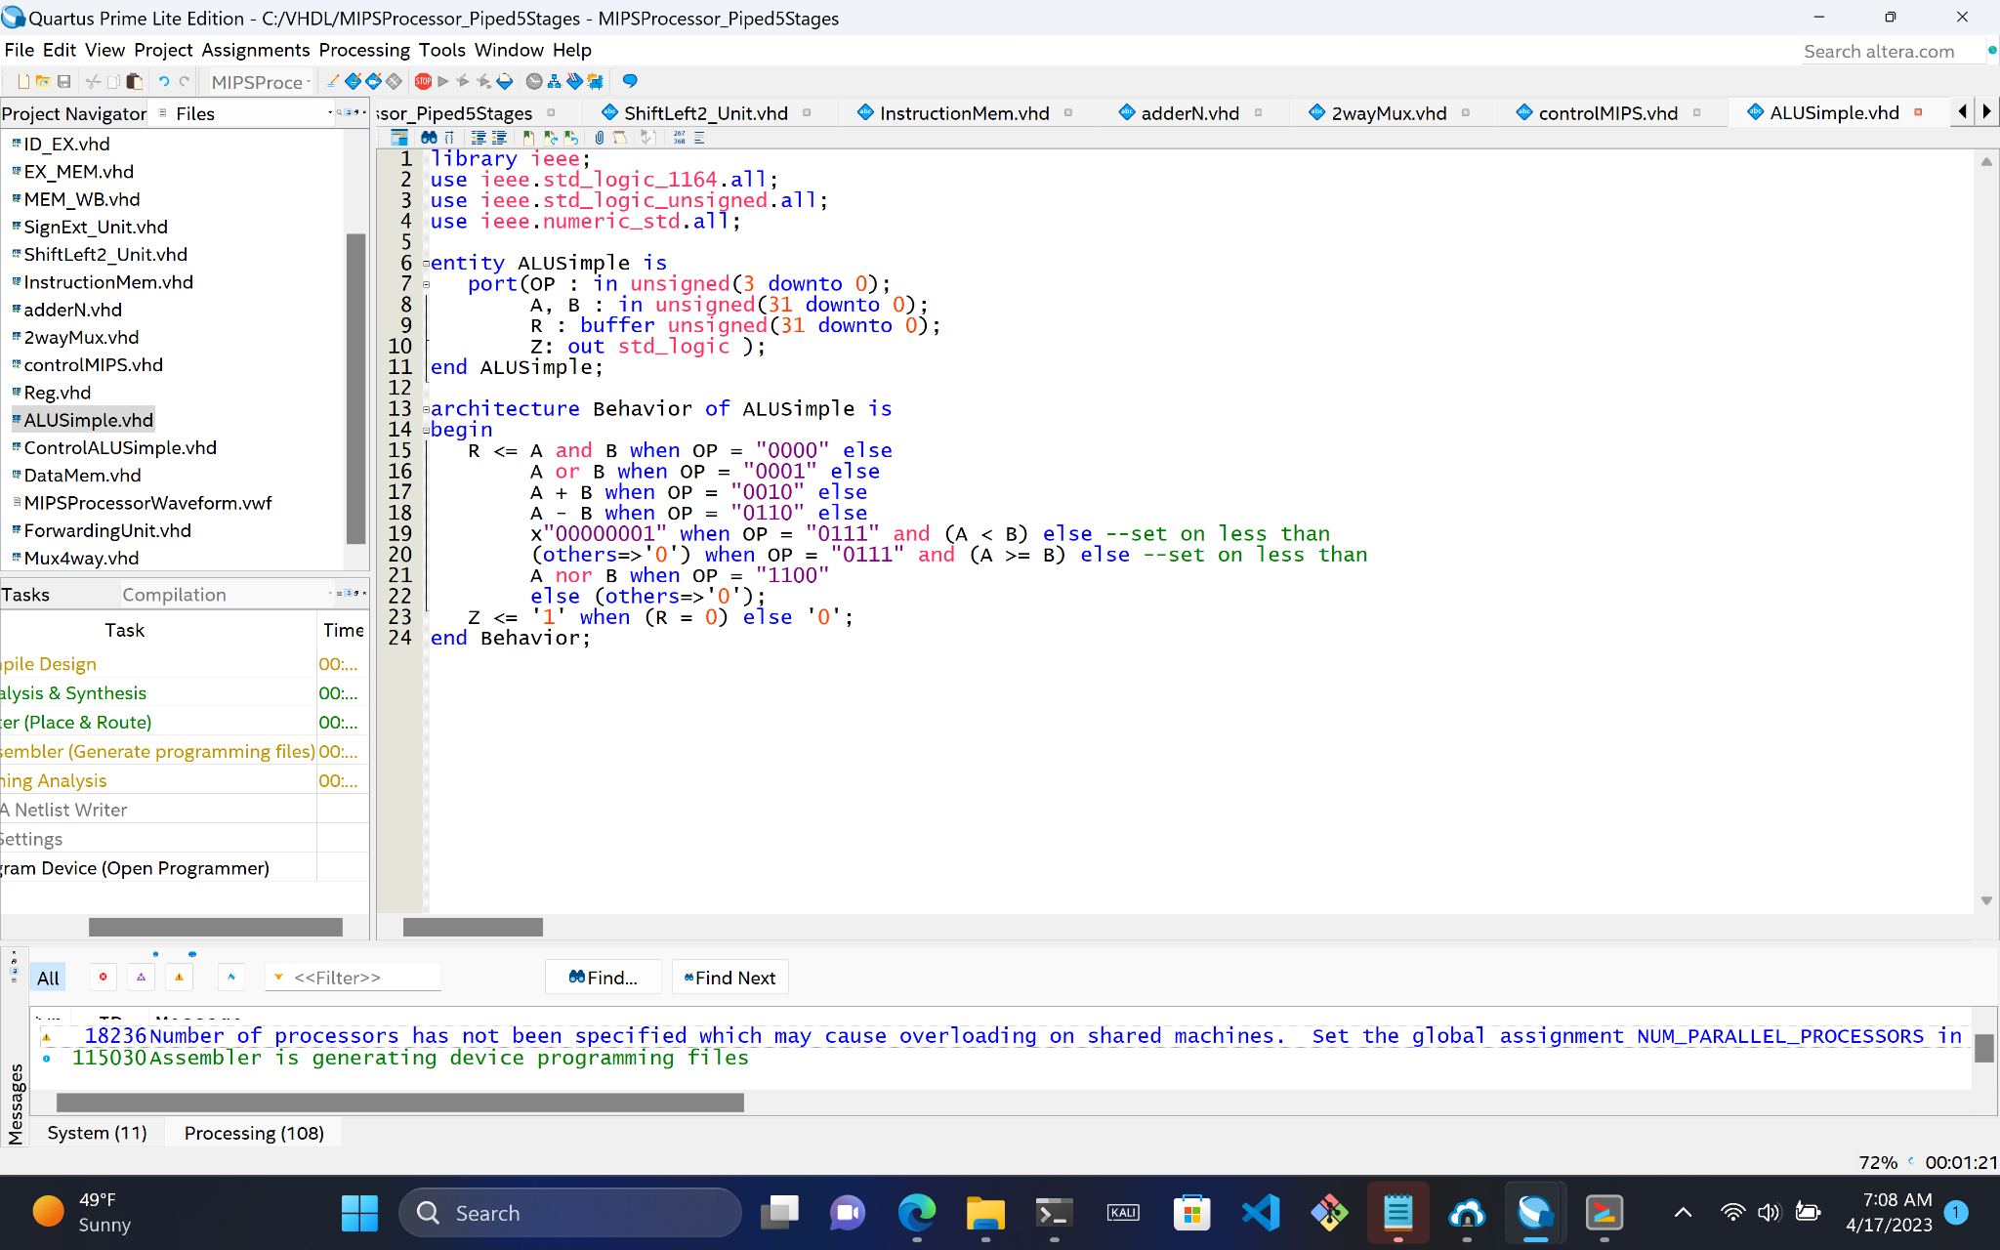
ALU
3 Inputs:
OP
A
B
2 Outputs:
R (Result)
Z (Zero flag)

Slide 8
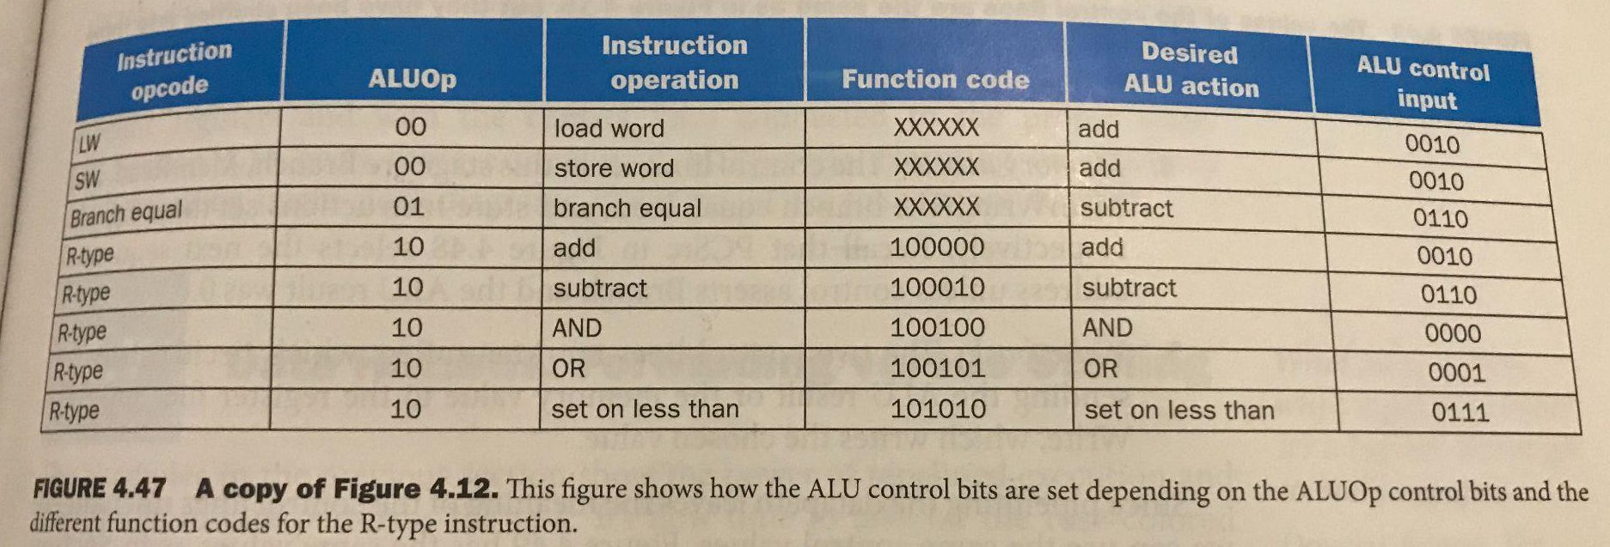
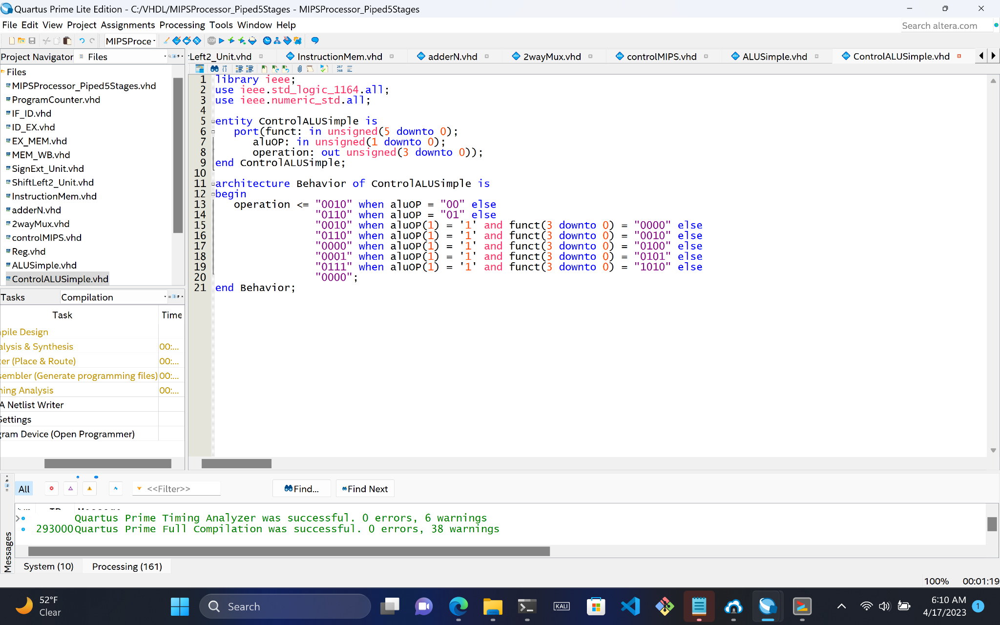
ALU Control
2 Inputs:
Funct
aluOP
1 Output:
Operation

Slide 9
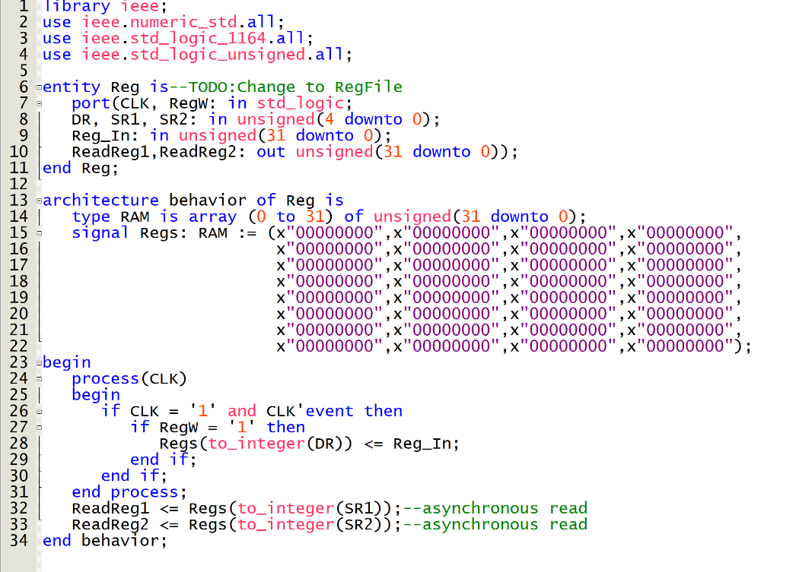
RegFile
6 Inputs:
Clk
RegW
DR (Destination register)
SR1 (Source register 1)
SR2 (Source register 2)
Reg_In
2 Outputs:
ReadReg1
ReadReg2

Slide 10
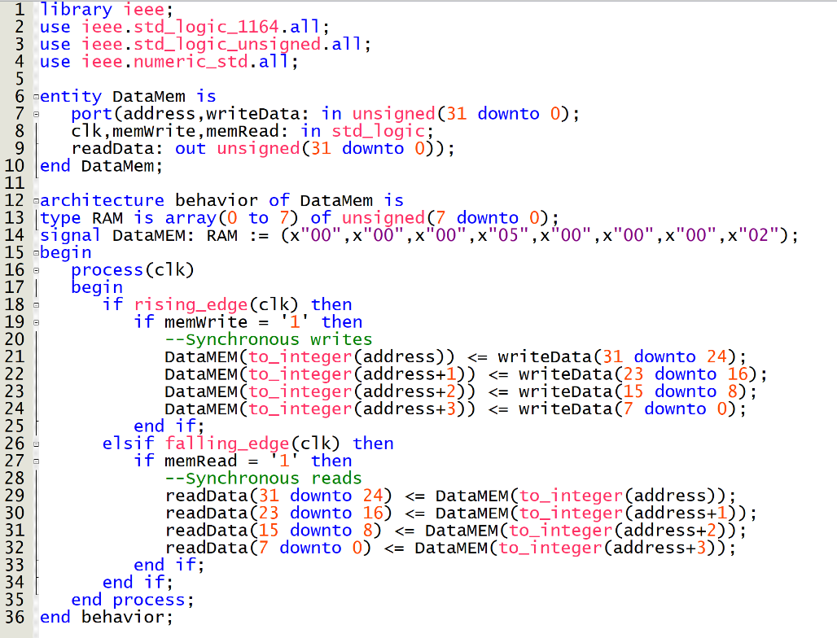
Data Memory
5 Inputs:
Clk
memWrite
memRead
Address
writeData
1 Output:
ReadData (32-bits)

Slide 11
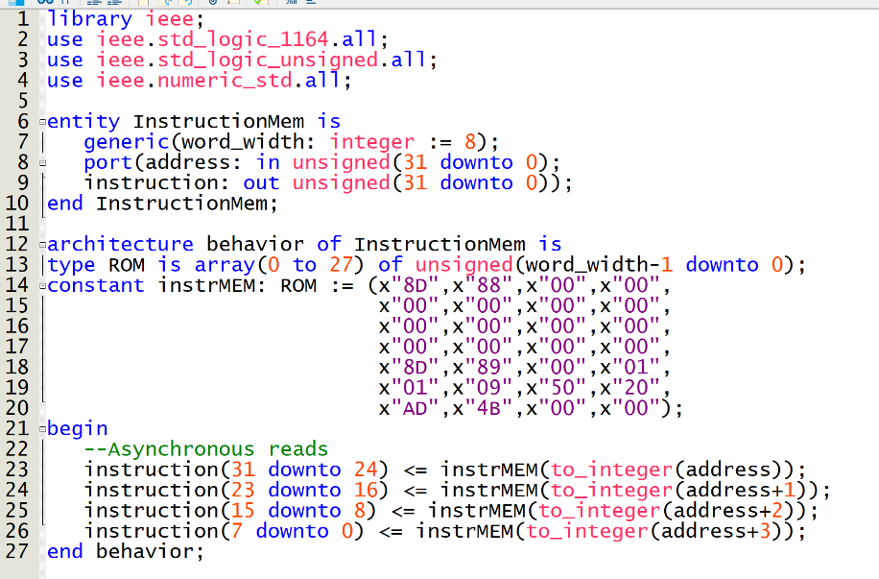
Instruction Memory
1 Input:
address (32-bits)
1 Output:
Instruction (32-bits)

Slide 12
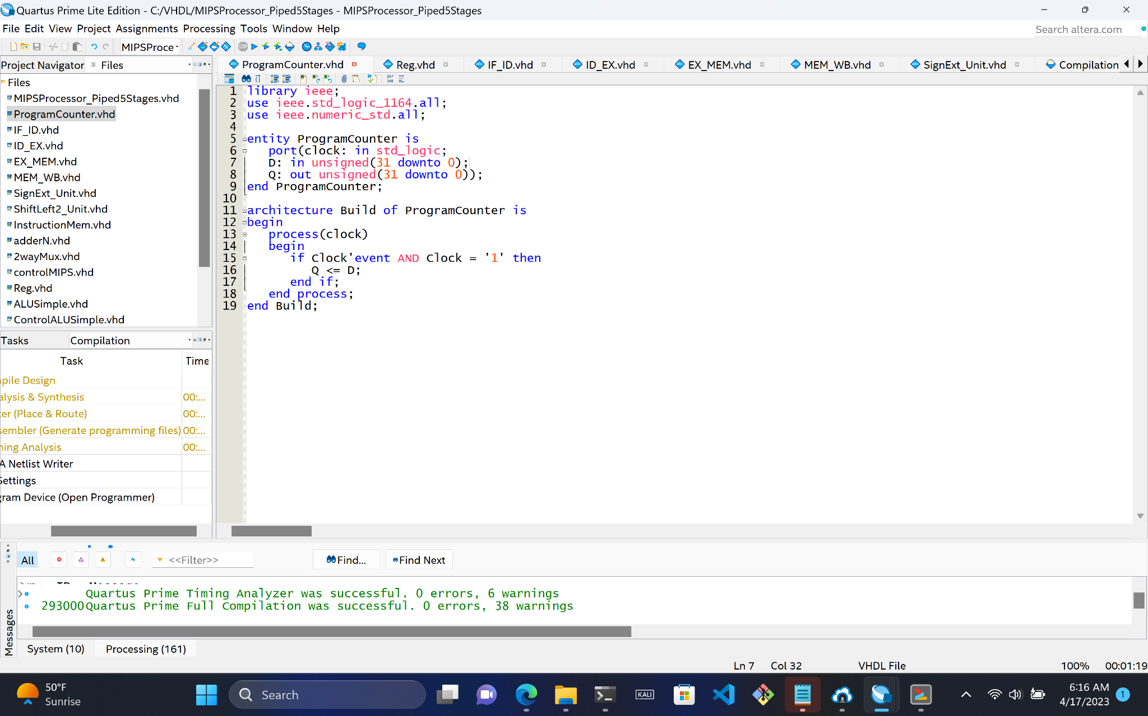
Program Counter
2 Inputs:
clock
D (32-bits)
1 Output:
Q (32-bits)

Slide 13
IF/ID, ID/EX, EX/MEM, MEM/WB Registers
PC+4 | Instruction
WB | M | EX | PC+4 | RD1 | RD2 | Sign-Ext | RS | RT | RD
WB | M | Add Result | Z | ALU Result | RD2 | RD
WB | data | ALU Result | RD

Slide 14
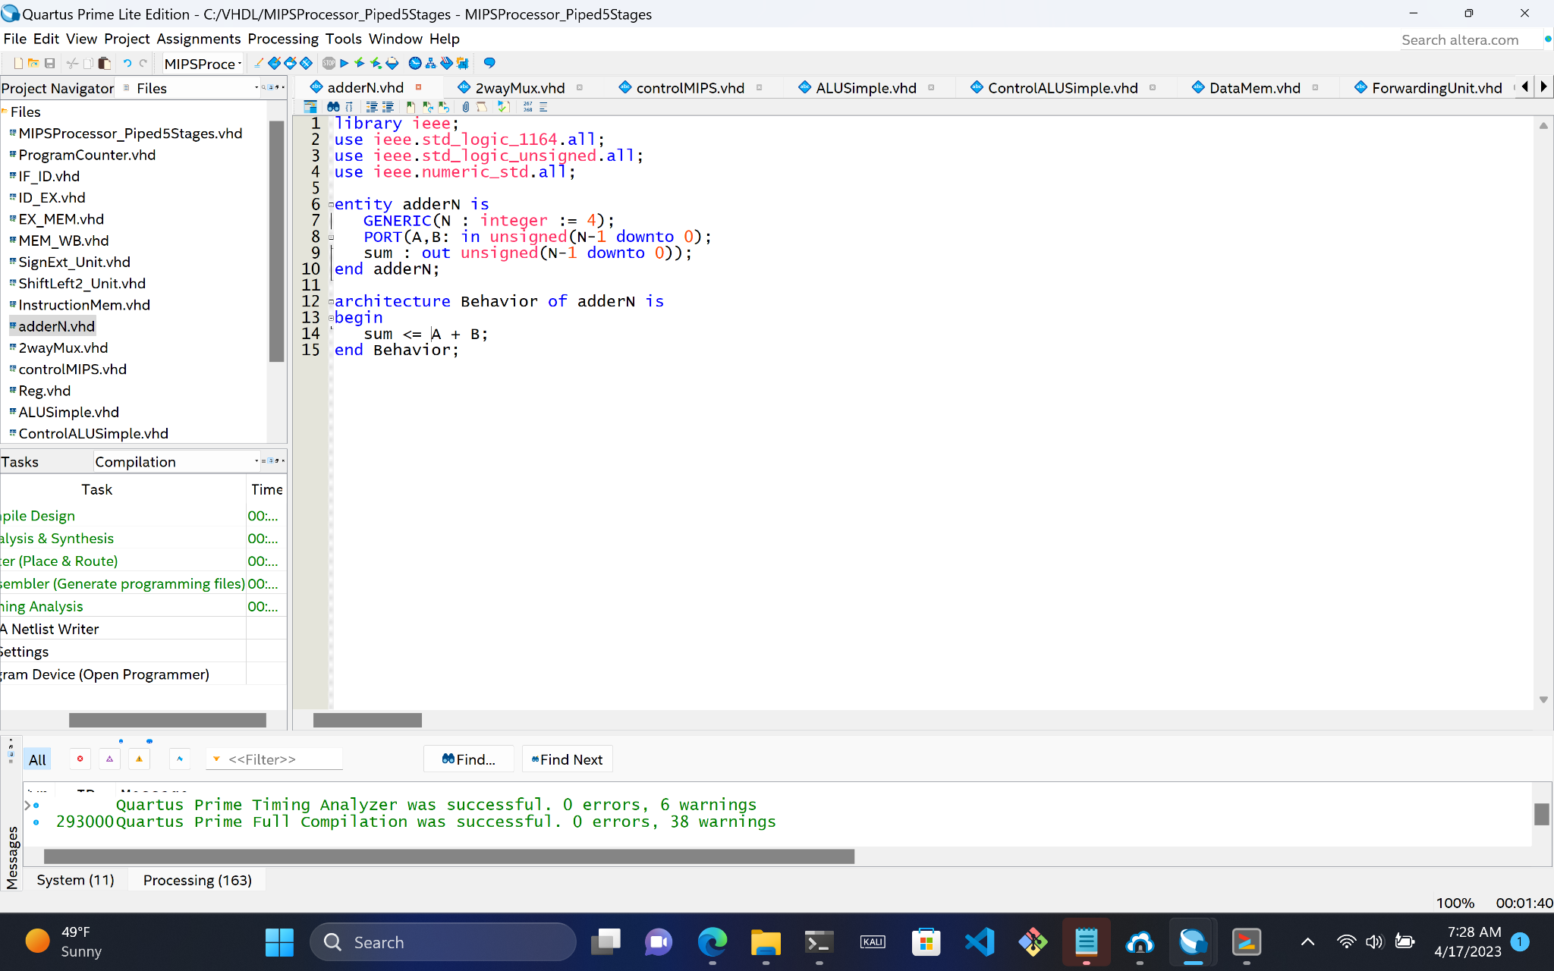
Adder
2 Inputs:
A
B
1 Output:
sum

Slide 15
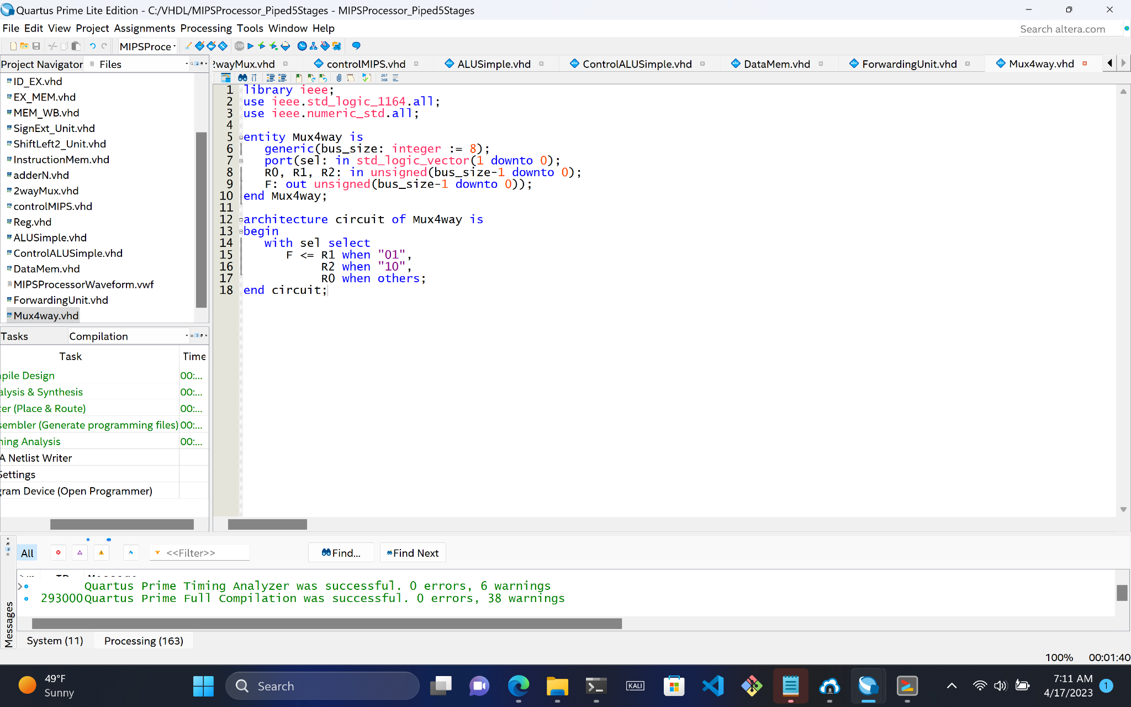
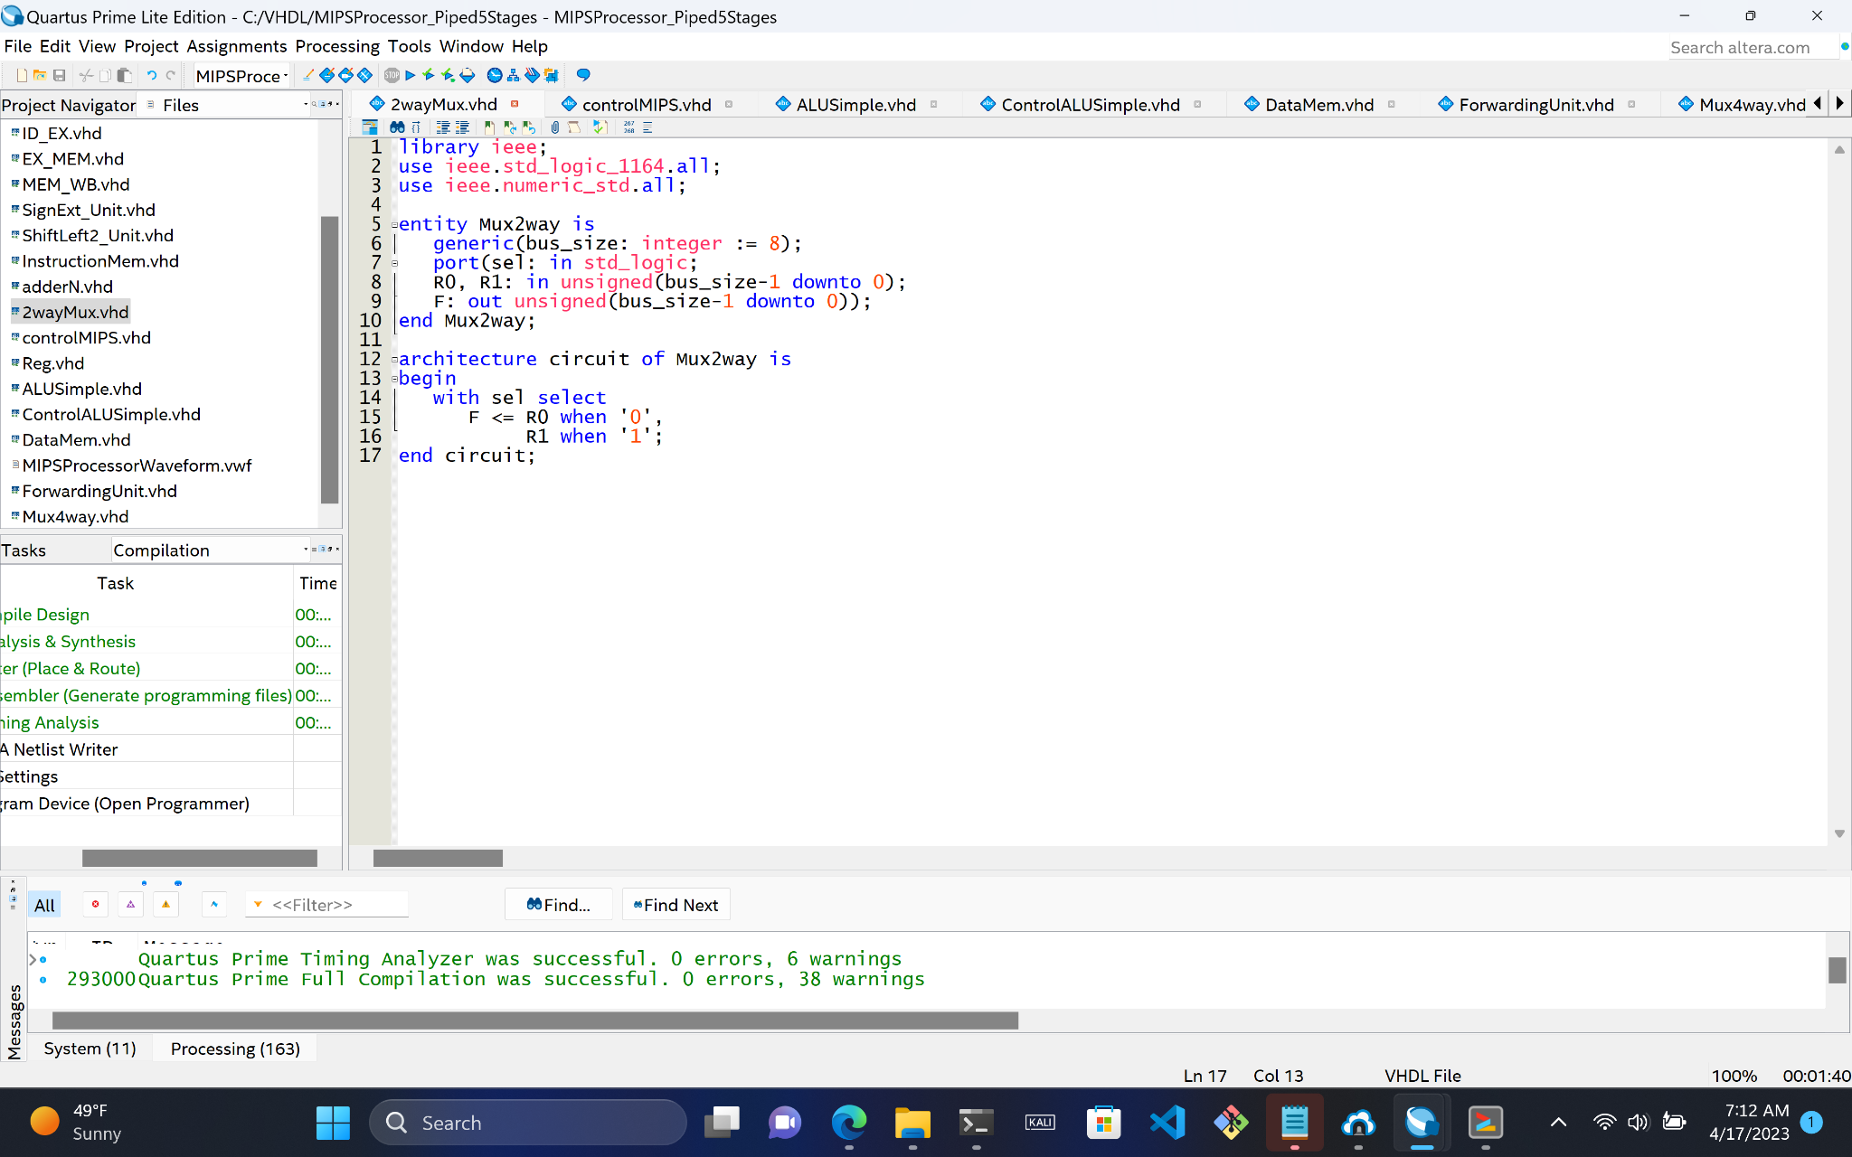
Multiplexers
Both a 4-way mux and 2-way mux

Slide 16
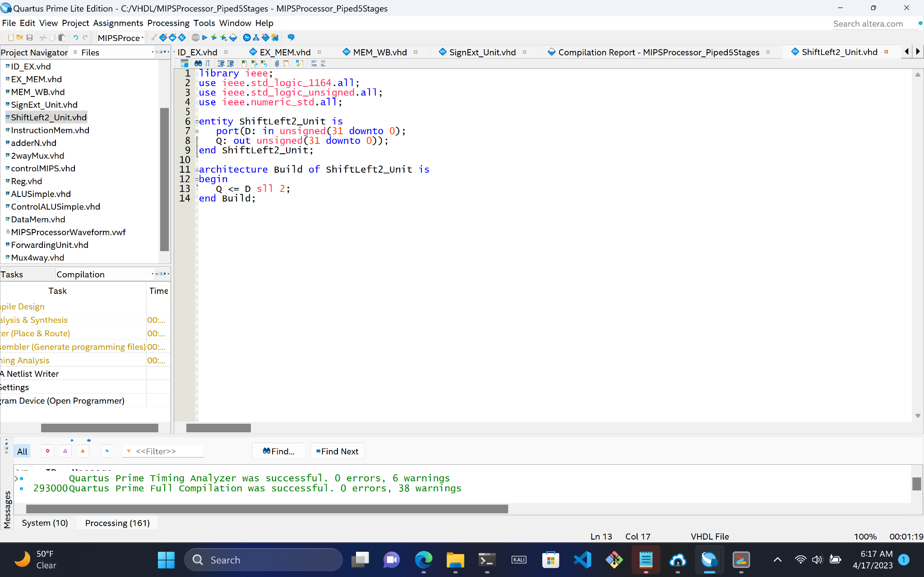
Shift Left 2 Unit
1 Input:
D (32-bits)
1 Output:
Q (32-bits)

Slide 17
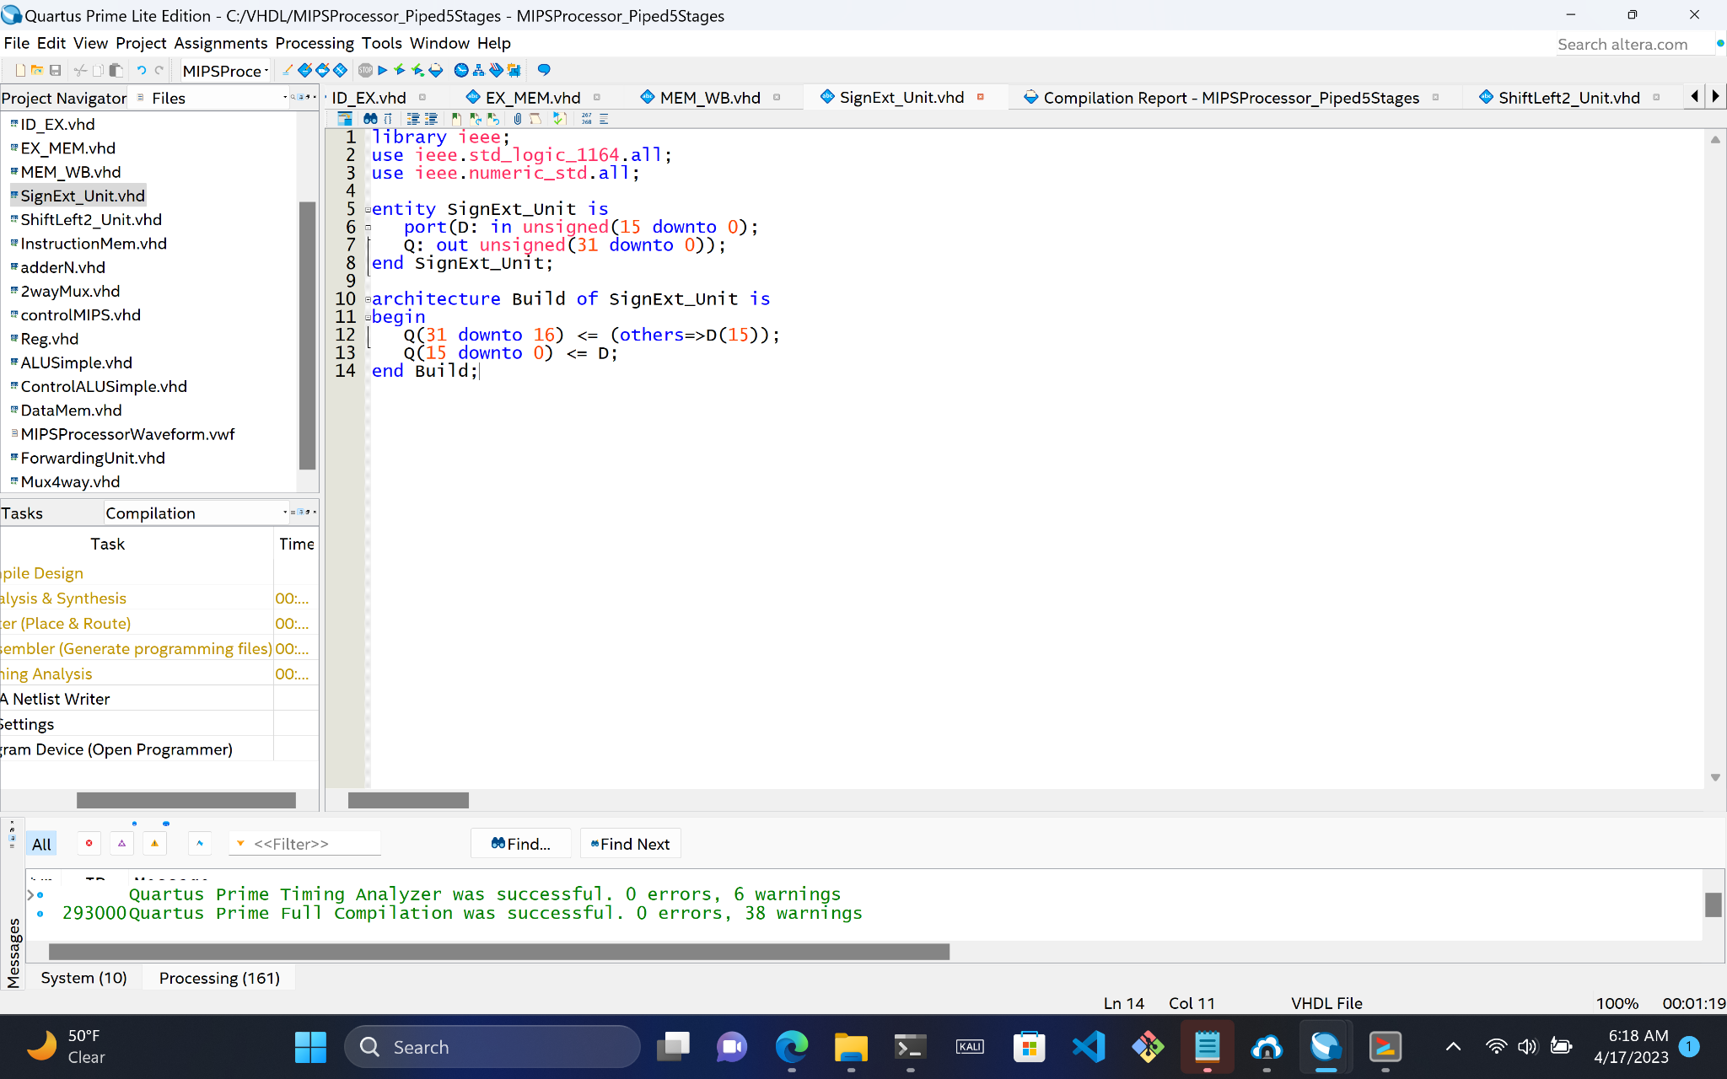
Sign-extend Unit
1 Input:
D (16-bits)
1 Output:
Q (32-bits)

Slide 18
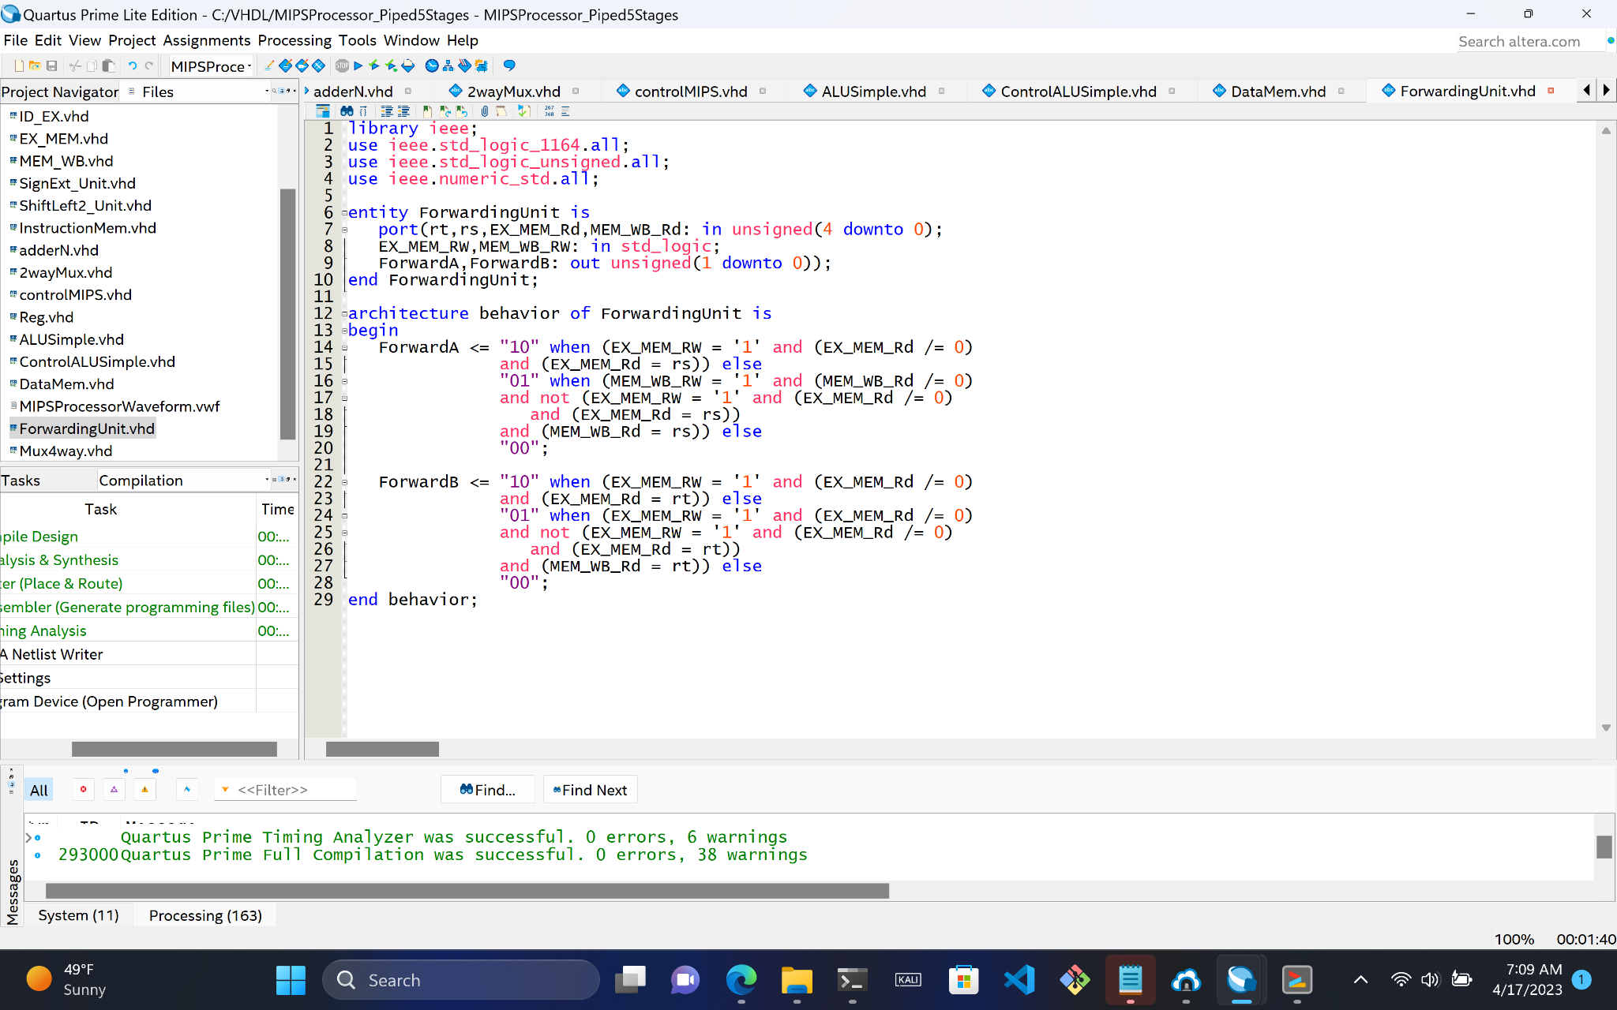
Forwarding Unit
6 Inputs:
Rt
Rs
EX_MEM_Rd
MEM_WB_Rd
EX_MEM_RW
MEM_WB_RW
2 Outputs:
ForwardA
ForwardB

Slide 19
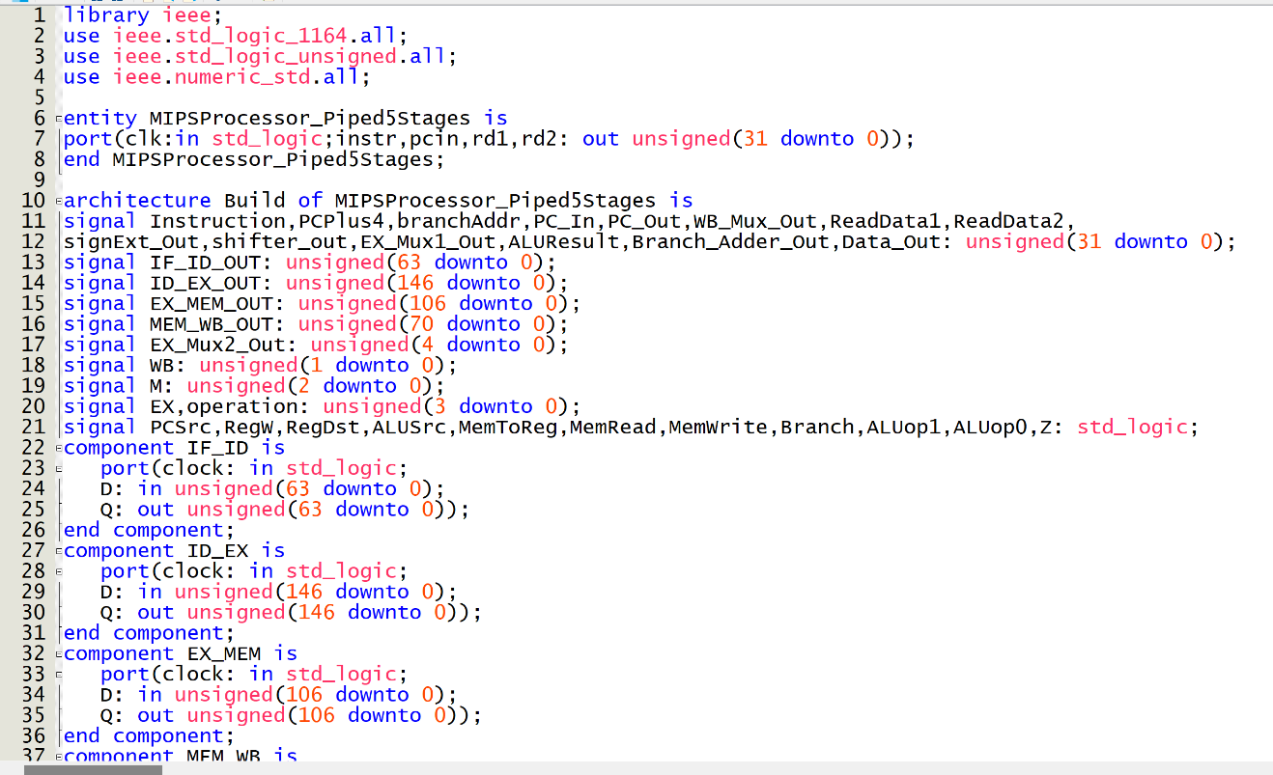
Upper-Level Entity
1 Input:
Clk
4 Outputs:
Instr (Instruction)
Pcin (Next PC)
Rd1 (ReadData1)
Rd2 (ReadData2)

Slide 20
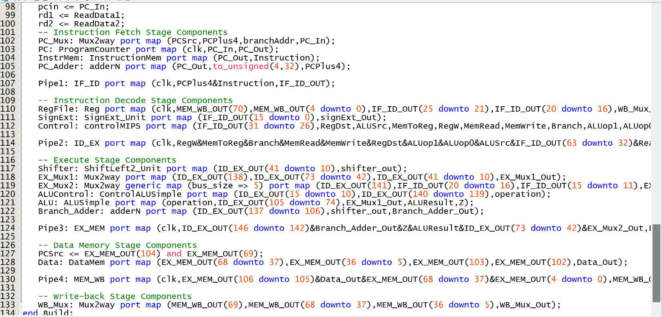
Upper-Level Entity

Slide 21


Verification Testing
Gray-box testing
Couldn’t get past functional test
What now!?

Slide 22
Questions?

